Slide 1
Machine Learning
CSE 4020
Dr. Abdul Quadir Md

Slide 2
Week 1

Slide 3
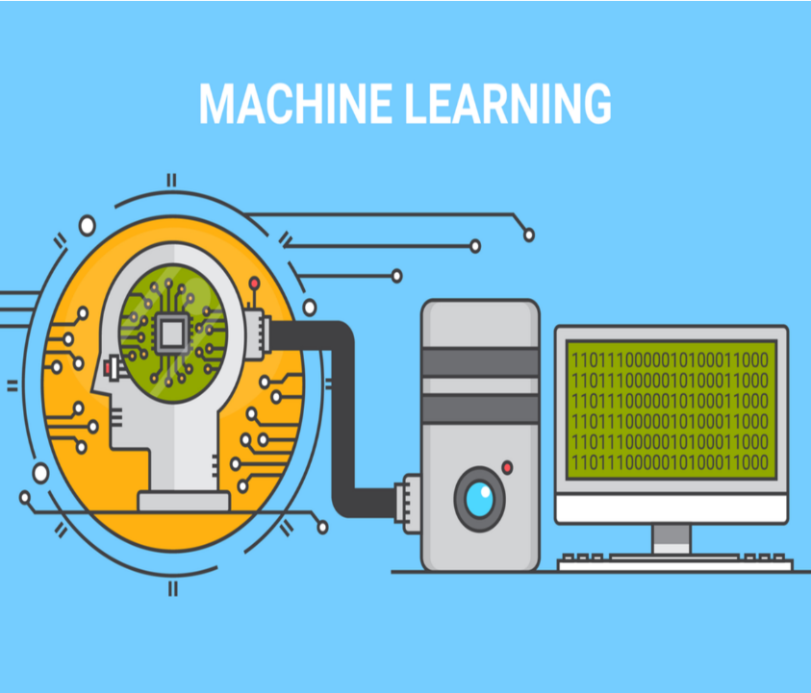
Machine Learning - An Introduction
Was coined by Arthur Samuel in 1959, an American pioneer
“It gives computers the ability to learn without being explicitly programmed”.
And in 1997, Tom Mitchell gave a “well-posed” mathematical and relational definition that

Slide 4

Machine Learning - An Introduction
A computer program is said to learn from:
experience E with respect to some task T
and
some performance measure P,
if its performance on T, as measured by P,
improves
with experience E

Slide 5
Artificial Intelligence
The word Artificial Intelligence comprises of two words “Artificial” and “Intelligence”.
Artificial refers to something which is made by human or non natural thing
Intelligence means ability to understand or think.
There is a misconception that Artificial Intelligence is a system, but it is not a system .
AI is implemented in the system.
There can be so many definition of AI, one definition can be “It is the study of how to train the computers so that computers can do things which at present human can do better.”
Therefore It is a intelligence where we want to add all the capabilities to machine that human contain.

Slide 6
Best Python libraries for Machine Learning
Numpy
Scipy
Scikit-learn
Theano
TensorFlow
Keras
PyTorch
Pandas
Matplotlib

Slide 7
Numpy
NumPy is a very popular python library for large multi-dimensional array and matrix processing, with the help of a large collection of high-level mathematical functions.
It is very useful for fundamental scientific computations in Machine Learning.
It is particularly useful for linear algebra, Fourier transform, and random number capabilities.
High-end libraries like TensorFlow uses NumPy internally for manipulation of Tensors.

Slide 8
Numpy
Array in Numpy is a table of elements (usually numbers), all of the same type, indexed by a tuple of positive integers.
In Numpy, number of dimensions of the array is called rank of the array.A tuple of integers giving the size of the array along each dimension is known as shape of the array.
An array class in Numpy is called as ndarray.
Elements in Numpy arrays are accessed by using square brackets and can be initialized by using nested Python Lists.

Slide 9
SciPy
SciPy is built in top of the NumPy
SciPy module in Python is a fully-featured version of Linear Algebra while Numpy contains only a few features.
Most new Data Science features are available in Scipy rather than Numpy
SciPy in Python is an open-source library used for solving mathematical, scientific, engineering, and technical problems.
It allows users to manipulate the data and visualize the data using a wide range of high-level Python commands.
SciPy is built on the Python NumPy extention.
SciPy is also pronounced as "Sigh Pi."

Slide 10
Scikit
Scikit-learn is one of the most popular ML libraries for classical ML algorithms.
It is built on top of two basic Python libraries, viz., NumPy and SciPy.
Scikit-learn supports most of the supervised and unsupervised learning algorithms.
Scikit-learn can also be used for data-mining and data-analysis, which makes it a great tool who is starting out with ML.

Slide 11
Theano
Theano is a popular python library that is used to define, evaluate and optimize mathematical expressions involving multi-dimensional arrays in an efficient manner.
It is achieved by optimizing the utilization of CPU and GPU. It is extensively used for unit-testing and self-verification to detect and diagnose different types of errors.
Theano is a very powerful library that has been used in large-scale computationally intensive scientific projects for a long time but is simple and approachable enough to be used by individuals for their own projects.

Slide 12
TensorFlow
TensorFlow is a Python library for fast numerical computing created and released by Google.
TensorFlow is a very popular open-source library for high performance numerical computation developed by the Google Brain team in Google.
As the name suggests, Tensorflow is a framework that involves defining and running computations involving tensors. It can train and run deep neural networks that can be used to develop several AI applications.
TensorFlow is widely used in the field of deep learning research and application.

Slide 13
Keras
Keras is a very popular Machine Learning library for Python.
It is a high-level neural networks API capable of running on top of TensorFlow, CNTK, or Theano.
It can run seamlessly on both CPU and GPU. Keras makes it really for ML beginners to build and design a Neural Network.
One of the best thing about Keras is that it allows for easy and fast prototyping.

Slide 14
Pandas
Pandas is a popular Python library for data analysis.
It is not directly related to Machine Learning.
When dataset must be prepared before training.
In this case, Pandas comes handy as it was developed specifically for data extraction and preparation.
It provides high-level data structures and wide variety tools for data analysis.
It provides many inbuilt methods for groping, combining and filtering data.

Slide 15
Introduction To Anaconda
Anaconda is an open-source distribution for python and R.
It is used for data science, machine learning, deep learning, etc.
With the availability of more than 300 libraries for data science, it becomes fairly optimal for any programmer to work on anaconda for data science.
Anaconda helps in simplified package management and deployment.
Anaconda comes with a wide variety of tools to easily collect data from various sources using various machine learning and AI algorithms.
It helps in getting an easily manageable environment setup which can deploy any project with the click of a single button.
Now that we know what anaconda is, let’s try to understand how we can install anaconda and set up an environment to work on our systems.

Slide 16
Week 2

Slide 17
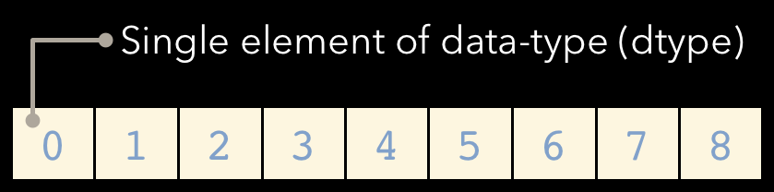
NUMPY
NumPy is a Python C extension library for array-oriented computing Efficient
In-memory
Contiguous (or Strided)
Homogeneous (but types can be algebraic)
NumPy is a Python C extension library for array-oriented computing Efficient
In-memory
Contiguous (or Strided)
Homogeneous (but types can be algebraic)
NumPy is suited to many applications Image processing
Signal processing Linear algebra
A plethora of others

Slide 18
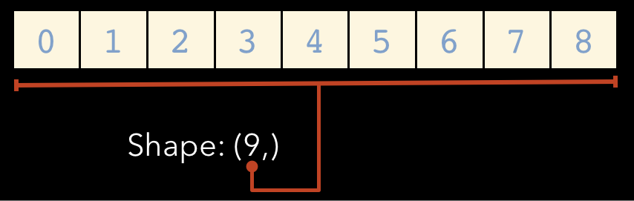
Array Shape
One dimensional arrays have a 1-tuple for their shape

Slide 19
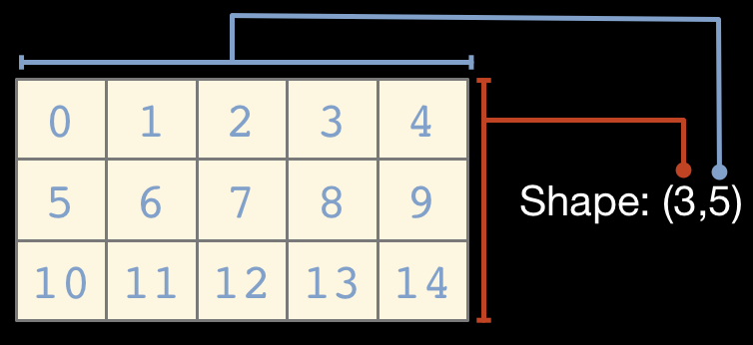
...Two dimensional arrays have a 2-tuple

Slide 20
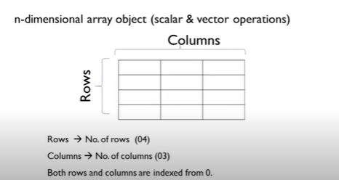
Numpy
Data being collected is in the form of rows and column
Column – attribute- characteristic of a particular domain eg: patient : age, sex, dob ,etc
Rows- data collected from different entities eg: patients data
We may want a package to compute the elements on the matrix like mean , median , SD, transpose/inverse of a matrix etc,

Slide 21
NUMPY - Methods commonly used
array – creating arrays - 1d-[] , 2d [[1,4], [2,3]]
Zero – init array with 0’s
ones - init array with 1’s
Shape – finding shape of array - rows and columns are there
ndim – to find the number of dimensions
size – to find the no of elements in an array
dtype – to find datatype of array
Itemsize - to find the size of one element

Slide 22
NUMPY - Methods commonly used
nbytes – finding total no of bytes
fill – to fill all elements with a value
arange – to create seq of no within a range with fixed step [1, 13, 2]
1- start, 10 – stop , interval of 2 --- o/p{1, 3, 5, 7,9,11}
linepace - to create list of nos within a range with var step
[1,11,15] - interval will be created by python itself automatically
eye - identity matrix – diagnaol matrix -1
random – creating different set of operations using random no

Slide 23
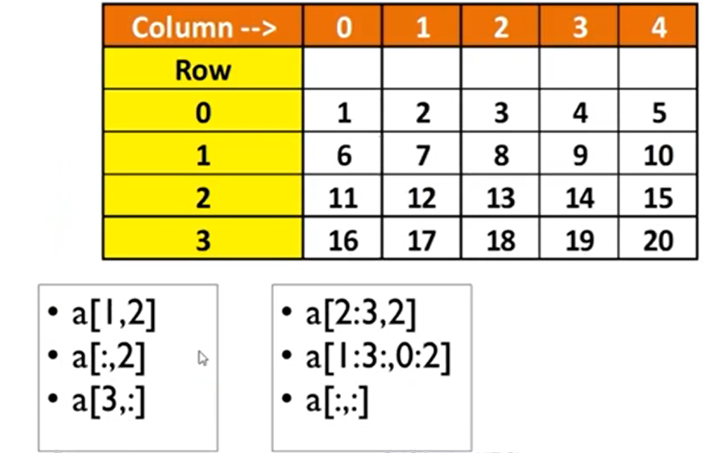
NUMPY - SLICING
8
3,8,13,18
16,17,18,19
FURTHER PART
[2-2, 2] - 13
FURTHER PART
[1,2 ] [0,1] ====[6 7]
[11 12]

Slide 24
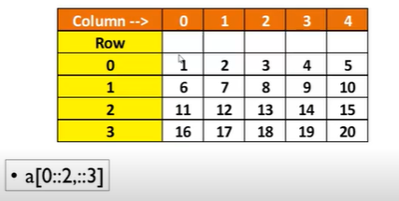
NUMPY - Striding
Rows
0- start value is 0
Stop value is not specified
Interval of 2
========
Column
Interval of 3
===========
[1 4]
[11 14]

Slide 25
Masking
arr11 = np.array([1,2,3,4,5,6,7,8,9])
mask = np.array([0,1,1,0,1,0,1,0,0],dtype=bool)
print(arr11[mask])

Slide 26
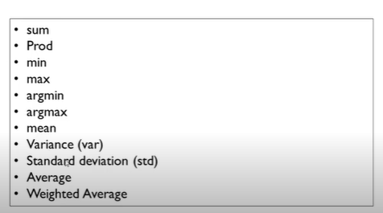
Methods

Slide 27
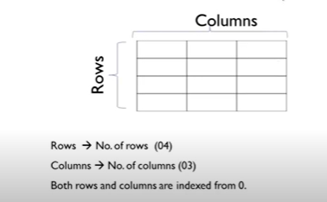
Pandas - Dataframe
Any dataset ends up with 2d matrix
We can bring any dimen to 2d matrix
map 2d to rel DB
Every row we add refers to a tuple

Slide 28
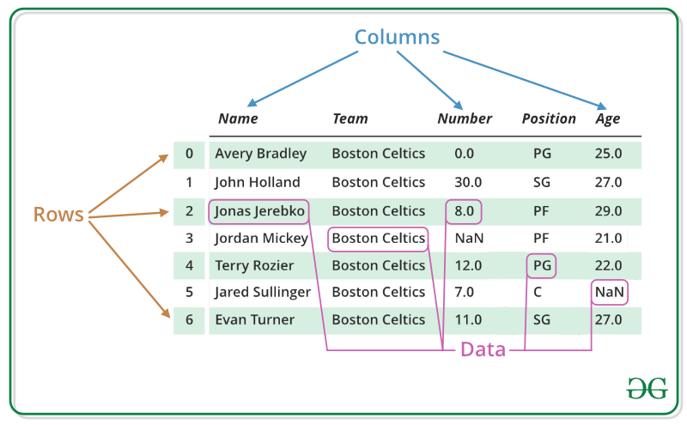
Pandas - Dataframe
A Data frame is a two-dimensional data structure, i.e., data is aligned in a tabular fashion in rows and columns.
Pandas DataFrame consists of three principal components, the data, rows, and columns.

Slide 29
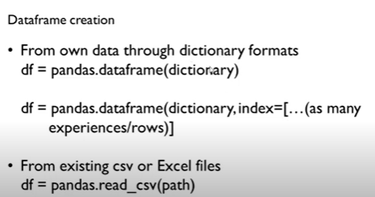
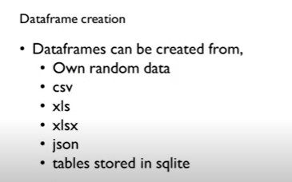
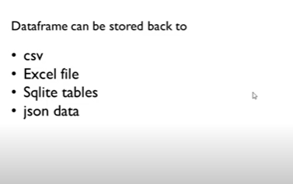
Pandas - Dataframe
Key : unique entity
Corresponding values to the key
Any method can be accessed using dot operator
Index correspondes to entity a ,b,c

Slide 30
Pandas - Dataframe
info –to get complete description of the data
shape- how many no of rows and coloumns
head – to read first few records (default - 5)
tail - to read last few records (default - 5)
drop_duplicate – removing duplicates in row (llr coloumns across the row)
inplace =true (operation has to be performed on the dataframe and stored back in the dataframe itself)
keep(first/last/false) (if you have 3 rows with same entity)

Slide 31
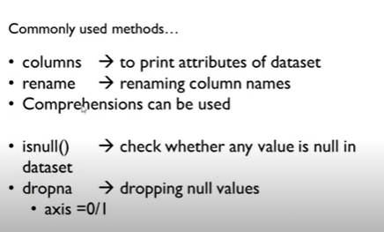
Pandas - Dataframe

Slide 32
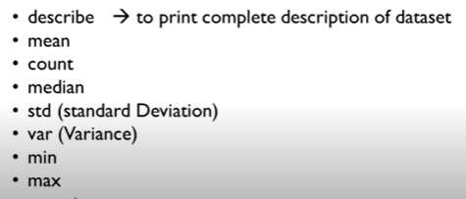
Pandas - Dataframe

Slide 33
Pandas - Slicing
loc - by name
iloc – by index

Slide 34
Week 3

Slide 35
Pyplot
matplotlib.pyplot is a collection of functions that make matplotlib work like MATLAB.
Each pyplot function makes some change to a figure: e.g., creates a figure, creates a plotting area in a figure, plots some lines in a plotting area, decorates the plot with labels, etc.

Slide 36
Types
Line Plot
Scatter
Pie
Bar Charts
Twin Axes
Histograms
Subplots
3D Plots

Slide 37
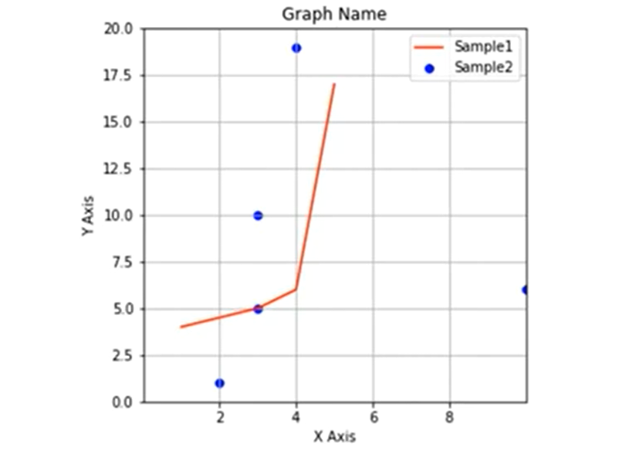
Basic 2D Graph Structure

Slide 38
Pyplot General
Xlabel, Ylabel
Xticks, Yticks
Legend
Title
Xlim, Ylim
Figure -> size
Savefig
Show

Slide 39
Seaborn
It is an amazing visualization library for statistical graphics plotting in Python.
It provides beautiful default styles and color palettes to make statistical plots more attractive.
It is built on the top of matplotlib library and also closely integrated to the data structures from pandas.
Seaborn aims to make visualization the central part of exploring and understanding data

Slide 40
Different categories of plot in Seaborn
Plots are basically used for visualizing the relationship between variables.
Those variables can be either be completely numerical or a category like a group, class or division.
Seaborn divides plot into the below categories
Relational plots: This plot is used to understand the relation between two variables.
Categorical plots: This plot deals with categorical variables and how they can be visualized.
Distribution plots: This plot is used for examining univariate and bivariate distributions
Univariate distribution: These are the distributions in which there is only one variable such as the heights of the students of a class.
Bivariate distribution: Distribution involving two discrete variable is called a bivariate distribution. For example, the heights and the weights of the students of a class in a school.

Slide 41
Different categories of plot in Seaborn
Regression plots: The regression plots in seaborn are primarily intended to add a visual guide that helps to emphasize patterns in a dataset during exploratory data analyses.
Matrix plots: A matrix plot is an array of scatterplots.
Multi-plot grids: It is an useful approach is to draw multiple instances of the same plot on different subsets of the dataset.

Slide 42
Week 4

Slide 43
Introduction to Supervised Learning

Slide 44
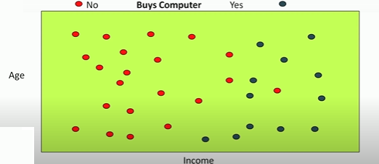
Supervised Learning- Classification
I have a customer database with two attributes age and income.
So I have each customer that comes to my shop.
I know the age of the customer and the income level of the customers .
Labeled data is for building a classifier:
Where the output is a discrete value in this case it is yes or no,
yes this is the person will buy a computer
No the person will not buy a computer.

Slide 45
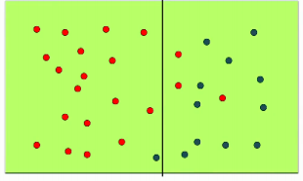
Possible Classifier
Goal is to come up with a function , that will take the age and income as the input and it will give you an output.
The person will buy the computer or not buy the computer
So there are many different ways in which you can create this function.
One way is :by drawing lines or curves on the input space.
But this classifier takes only income into consideration

Slide 46
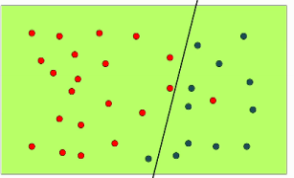
Possible Classifier
Another way
Now we got those two red points that those just keep that points are on the wrong side of the line earlier now seem to be on the right side
Left - will not buy a computer
Right, buy a computer
Performance measure is improved
But this classifier takes two parameters :age and income into consideration

Slide 47
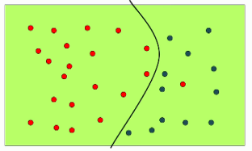
Possible Classifier
Another way
It is now a quadratic
Define three parameters .
ax²+ bx+ c,
Three parameters in order to find the quadratic

Slide 48
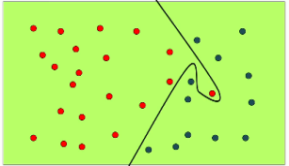
Possible Classifier
Another way
Not sure how many parameters you need
Its complex
He was sure to buy , but some issue like
There might be emergency call/situation for this customer
Not recorded the data

Slide 49
Inductive Biases
Assumption Made :
Everything to the left - will not buy the computer
Everything to the right - will buy a computer
Lines/curves are able to segregate people who buy from who do not buy
Kind of an assumption made about the distribution of the input data and the class labels.
So this kind of assumptions that we make about these lines are known as inductive biases
Language bias : the type of lines that I am going to draw
Search bias: what order am I going to examine all these possible lines.

Slide 50
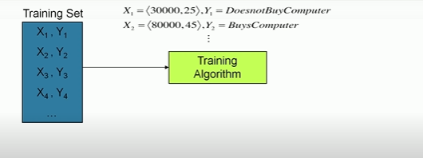
The Flow

Slide 51
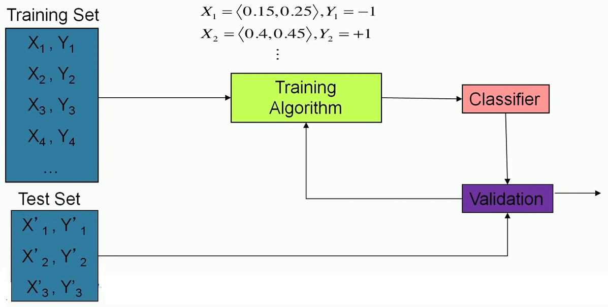
The Flow

Slide 52
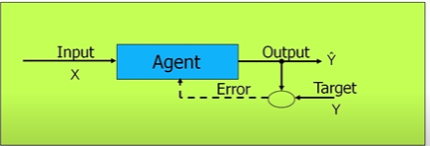
Training
Learning agent will take an input and it will produce an output Ŷ which it thinks is the correct output
But it will compare it against the actual target Y it was given for the in the training
And relearn for errors
Its an iterative process
Most of the classification algorithms or even regression algorithms operates in similar fashion

Slide 53
Few Applications
Credit card fraud detection (Valid transaction or not)
Sentiment analysis(+ve review / -ve review)
Churn prediction (a customer who is in the system is likely to leave your system or is going to continue )

Slide 54
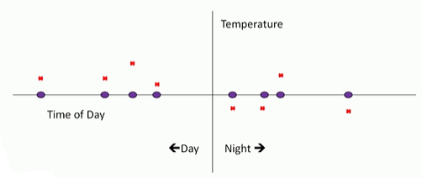
Prediction or Regression
Where the output to predict is no longer a discrete value it is not like – will buy a computer or does not buy a computer
It is more of a continuous value
Different times of day you have recorded the temperature
Input to the system- Time of day
Output from the system - Temperature that was measured at a particular point at the time
You are going to get your experience or your training data is going to take this form.
Blue points - input
Red points - the outputs that you are expected to predict
Points: Left (Day) , Right (Night)

Slide 55
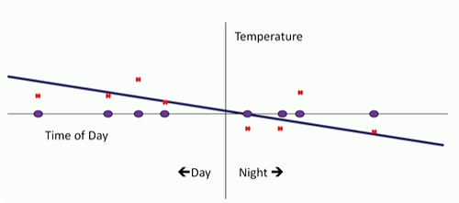
Prediction or Regression
Just like previous case of classification : simple as possible fit - draw a straight line that is as close as possible to these points
Simple solution - certain points at which we are making large errors right - try to fix that.
The Fig shows day time temperatures are more or less fine
Night times we seem to be doing something really off because we are going off too much to the right-hand side.
How if you could do something more complex
Just like in the classification case where we wanted to get that one point right so we could try and fit all these temperatures that were given to us by looking at a sufficiently complex curve.

Slide 56
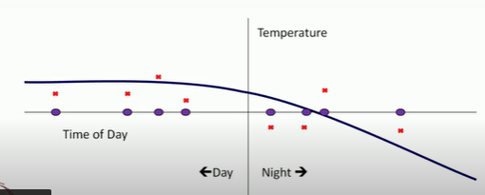
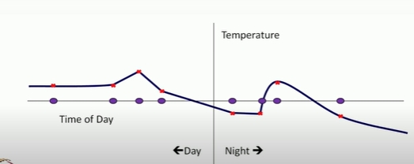
Prediction or Regression
Try and fit all these temperatures that were given to us by looking at a sufficiently complex curve.

Slide 57
Prediction or Regression
Just like in the classification case where we wanted to get that one point so we could try and fit all these temperatures that were given to us by looking at a sufficiently complex curve.
These kinds of solutions where we try to fit the noise in the data we are trying to make the solution predict the noise in the training data correctly are known as over fitting
Over fit solutions and one of the things that we look to avoid in machine learning is to over fit to the training data

Slide 58
Generate Synthetic Data with Python

Slide 59
Generate Synthetic Data with Python
A problem with machine learning, especially when you are starting out and want to learn about the algorithms, is that it is often difficult to get suitable test data.
Some cost a lot of money, others are not freely available because they are protected by copyright.
Therefore, artificially generated test data can be a solution in some cases.

Slide 60
Generate Synthetic Data with Python
On the one hand, there are small toy data sets
But it also offers larger data sets that are often used in the machine learning community to test algorithms or also serve as a benchmark.
It provides us with data coming from the 'real world'.

Slide 61
Generate Synthetic Data with Python
But in many cases this is still not sufficient.
Maybe you find the right kind of data, but you need more data of this kind or the data is not completely the kind of data you were looking for, e.g. maybe you need more complex or less complex data.
This is the point where you should consider to create the data yourself.

Slide 62
Generate Synthetic Data with Python
Here, sklearn offers help.
It includes various random sample generators that can be used to create custom-made artificial datasets.
Datasets that meet your ideas of size and complexity.

Slide 63
The Need for Synthetic Data
There are many other instances, where synthetic data may be needed.
For example, real data may be hard or expensive to acquire, or it may have too few data-points.
Another reason is privacy, where real data cannot be revealed to others

Slide 64
Few reasons why you need generated data
Can your models handle noisy labels?
What happens when 99% of your labels are negative and only 1% are positive?
if your models can tell you which features are redundant?
In case of model provided feature importances how does the model handle redundant features.
Does removing redundant features improve your model’s performance?
How does your model behave when Redundant features, noise and imbalance are all present at once in your dataset?
If you have N datapoints and M features, what are the safe values of N,M so your model doesn’t overfit?

Slide 65
Week 5

Slide 66
What is Regression Analysis?
Regression analysis is a form of predictive modelling technique which investigates the
relationship between a dependent (target) and independent variable(s) (predictor).
Predicting: This technique is used for forecasting, time series modelling and finding the causal effect relationship between the variables.
For example, relationship between rash driving and number of road accidents by a driver is best studied through regression.

Slide 67
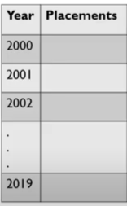
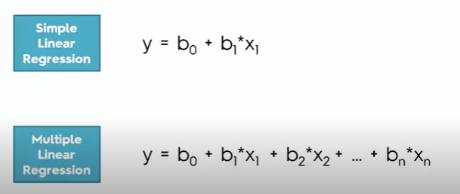
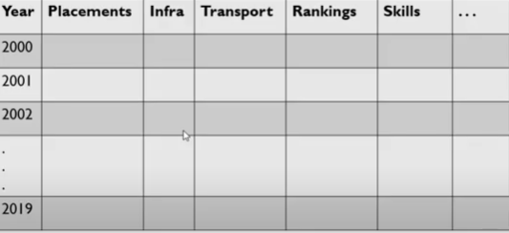
Types (x= studying, y=grade)

Slide 68
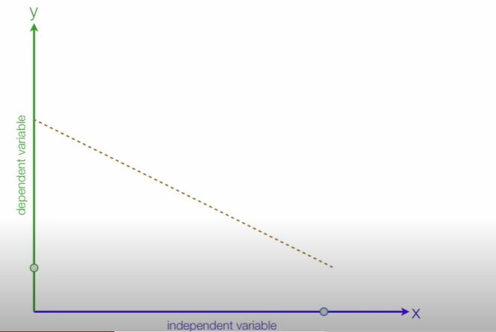
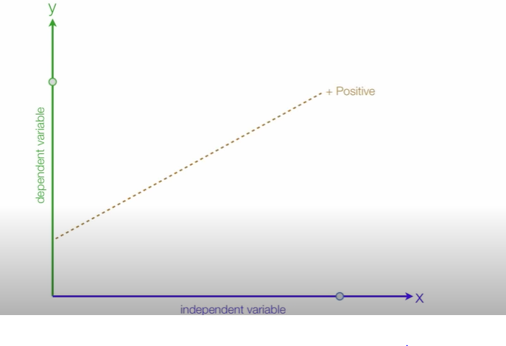
Positive Relationship (x= Studying , y=Grades) Negative Relationship (x= Instagram y= Grades)

Slide 69
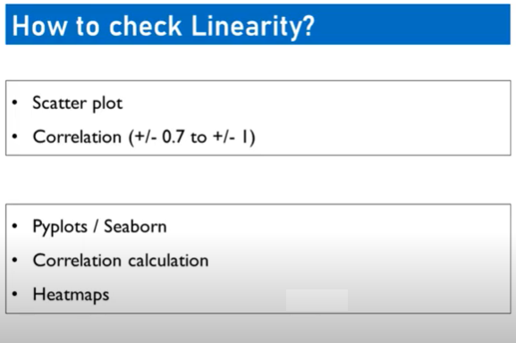
Scatter plot
Draw straight line which connects most of the data points
Correlation

Slide 70
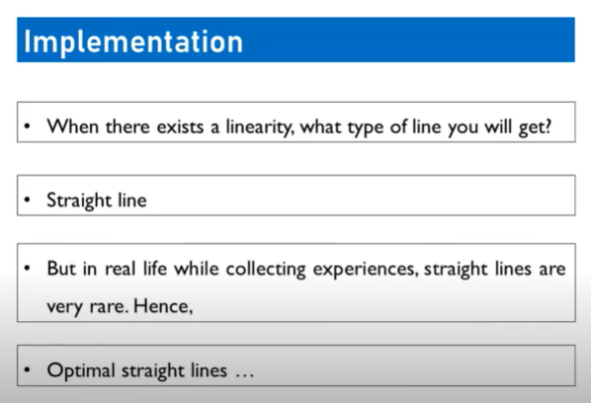

Slide 71
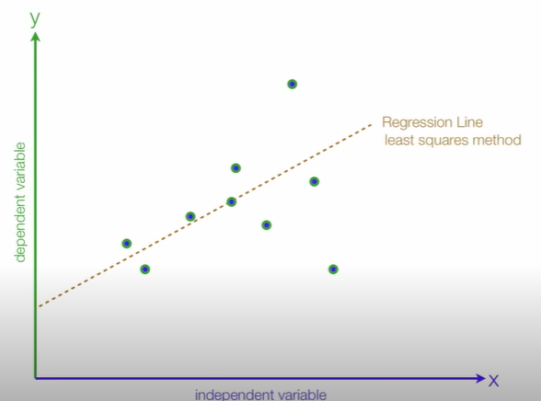
Population Regression Line

Slide 72
Population Regression Line
Regression Line
y
Estimated
Dependent Variables
Actual
Errors
x
Independent Variables

Slide 73
Population Regression Line
Example
Population regression function =
Regression Line
𝑦 = 𝑏₀+𝑏₁x
𝑦 = Estimated Grades
x = Study Time
𝑏₀= Intercept
𝑏₁= Slope
Estimated Grades
𝑏₁= Slope
𝑏₀= Intercept
Study Time

Slide 74
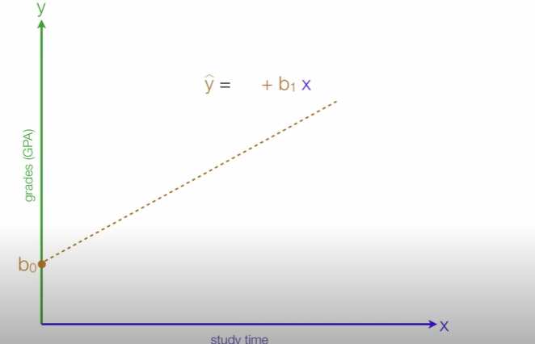
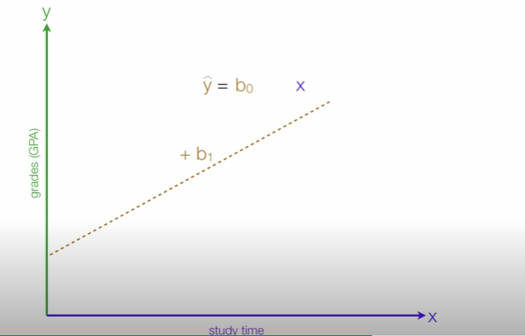
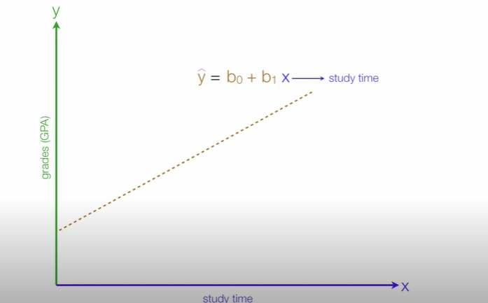
Regression

Slide 75
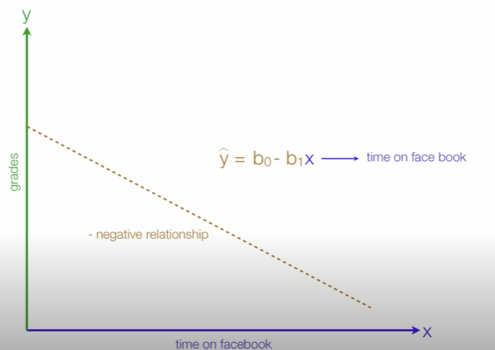
Regression

Slide 76

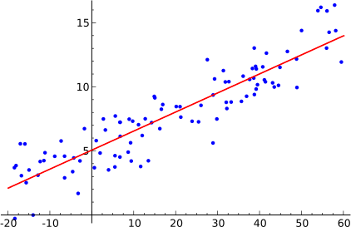
Simple Linear Regression Model
Simple linear regression model is a model with a single regressor x that has a linear relationship with a
response y.
Simple linear regression model:
Intercept
Slope
Random error component
y = 𝑏₀+𝑏₁x + ɛ
Response variable Regressor variable
In this technique, the dependent variable is continuous
and random variable, independent variable(s) can
be continuous or discrete but it is not a
random
variable, and nature of regression line is linear.

Slide 77
Least Square Estimation for Parameters
The parameters 𝑏₀ and 𝑏₁are unknown and must be estimates using sample data:
(𝑥₁,𝑦₁), (𝑥₂,𝑦₂),……(𝑥_{𝑛},𝑦_{𝑛})
𝑦 = 𝑏₀+𝑏₁x + ɛ
y
y
𝑦 = 𝑏 +𝑏 x + ɛ
𝑖 0 1 i
i
x
x

Slide 78
Calculate linear regression (using least square method)
x | y
1 | 2
2 | 4
3 | 5
4 | 6
5 | 7

Slide 79
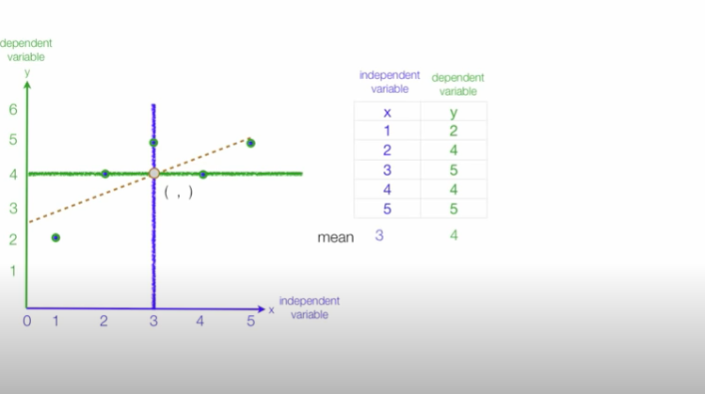
Calculate linear regression using least square method (minimize the distance between the errors)

Slide 80
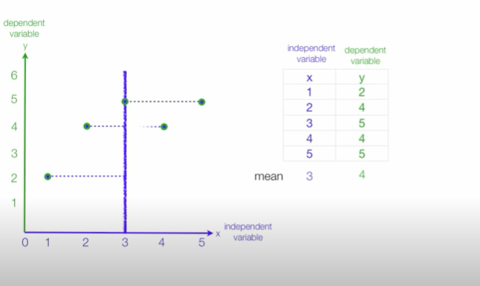
Distance from the x value to the mean for all observations

Slide 81
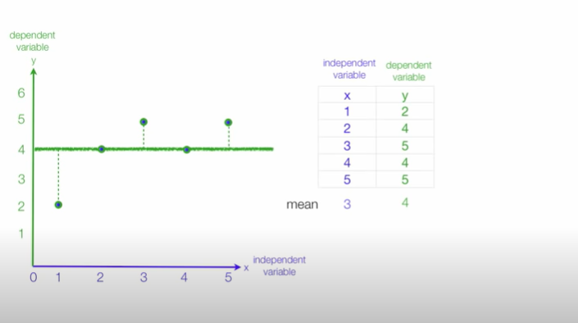
Distance from the y value to the mean for all observations

Slide 82
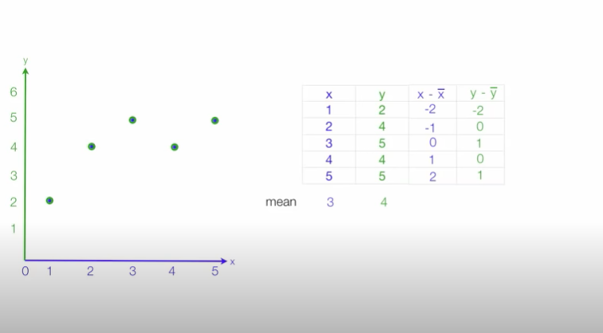
Distance from the x and y value to the mean for all observations

Slide 83
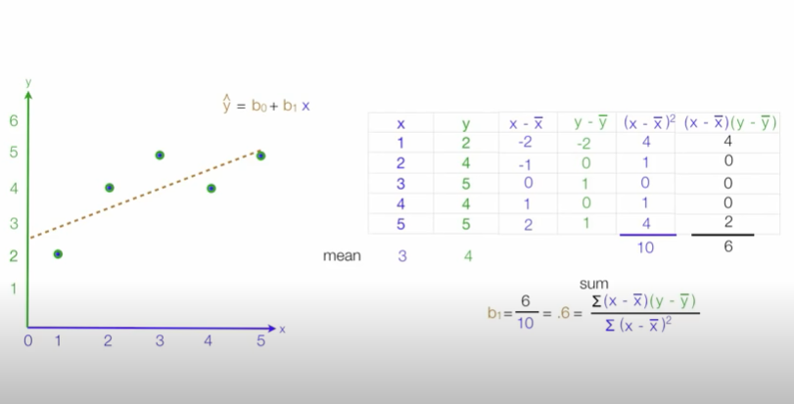
To calculate b₁

Slide 84
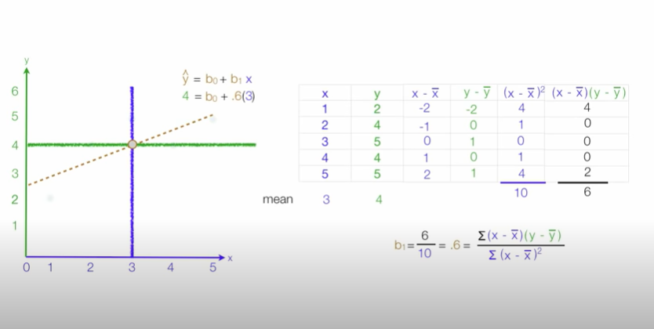
To calculate b₀

Slide 85
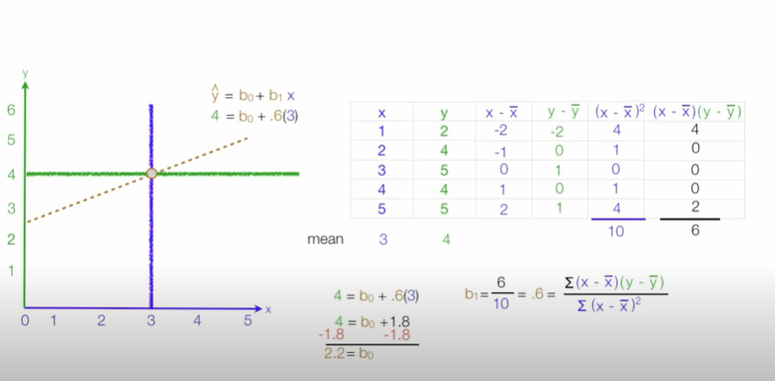
To calculate b₀

Slide 86
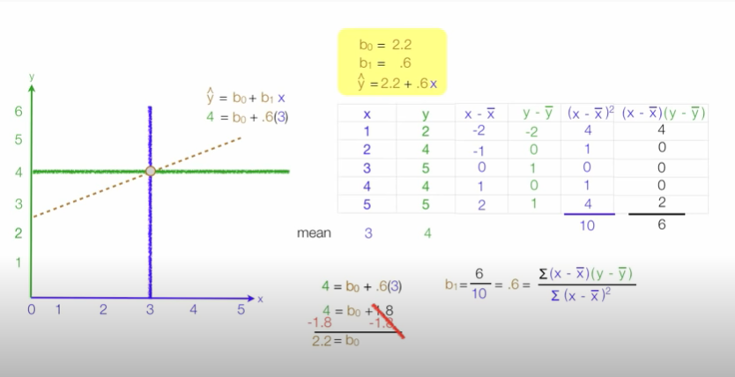
To calculate b₀

Slide 87
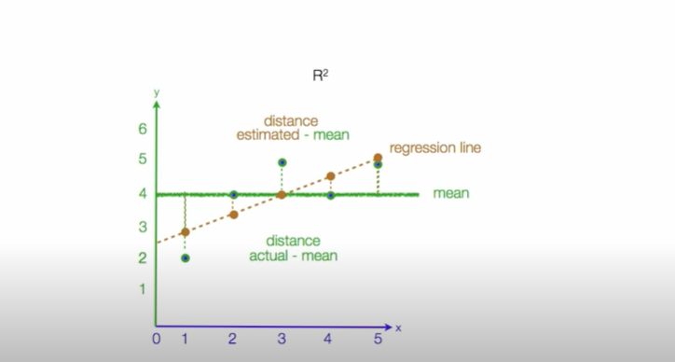
CALCULATING R SQUARED

Slide 88

Calculating R² Using Regression Analysis
R-squared is a statistical measure of how close the data are to the fitted regression line(For measuring the
goodness of fit ). It is also known as the coefficient of determination.
Firstly we calculate distance between actual values and mean value and also calculate distance between estimated value and mean value.
Then compare both the distances.

Slide 89

R squared Predicted
y - mean

Slide 90



R squared Estimated

Slide 91


Example

Slide 92




Performance of Model

Slide 93

Standard error of the Estimate (Mean square error)
The standard error of the estimate is a measure of the accuracy of predictions.
Note: The regression line is the line that minimizes the sum of squared deviations of prediction (also called the sum of squares error).
The standard error of the estimate is closely related to this quantity and is defined below:
Where
Y = actual value Y’= Estimated Value
N = No. of observations

Slide 94

Difference between R² and Standard error of the Estimate

Slide 95


Example : Standard Error of the Estimate used in Regression Analysis (Mean Square Error)
Error: estimated distance between actual

Slide 96

Example : Standard Error of the Estimate used in Regression Analysis (Mean Square Error)
Where n is the no of observations

Slide 97

Example : Standard Error of the Estimate used in Regression Analysis (Mean Square Error)
Where n is the no of observations

Slide 98

Example : Standard Error of the Estimate used in Regression Analysis (Mean Square Error)
Where n is the no of observations

Slide 99

Example : Standard Error of the Estimate used in Regression Analysis (Mean Square Error)
Where n is the no of observations

Slide 100

Difference

Slide 101


Slide 102


Slide 103


Slide 104


Slide 105




Slide 106



Slide 107


Slide 108

Mean will change bec filled up with nan fill up with mean whose ffmc>90

Slide 109

All the missing values has been filled

Slide 110


Slide 111


Slide 112


Slide 113


Slide 114


Slide 115


